Slide 1
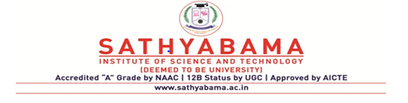
SCS7023
CLOUD COMPUTING

Slide 2
UNIT 3
CLOUD DEPLOYMENT MODELS
UNIT 3 CLOUD DEPLOYMENT MODELS AND VIRTUALIZATION 9 Hrs. Deployment models: Public cloud – Private Cloud –Hybrid cloud – Community cloud - Need for virtualization – Types of Virtualization – Virtualization OS – VMware, KVM – System VM – Process VM - Virtual Machine Monitor – Properties - Xen, Hyper V, Virtual Box, Eucalyptus .

Slide 3
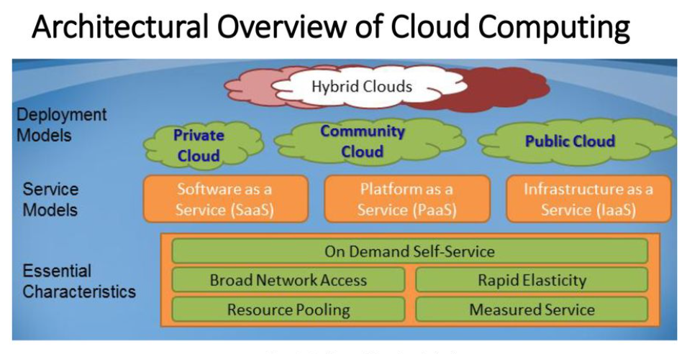
OVERVIEW OF CLOUD COMPUTING

Slide 4
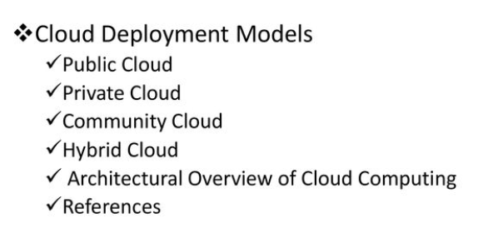
CLOUD DEPLOYMENT MODELS

Slide 5
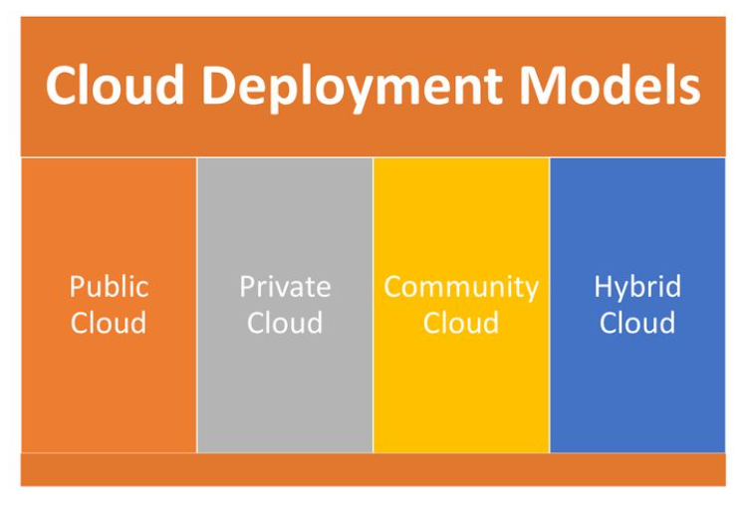
CLOUD DEPLOYMENT MODELS

Slide 6
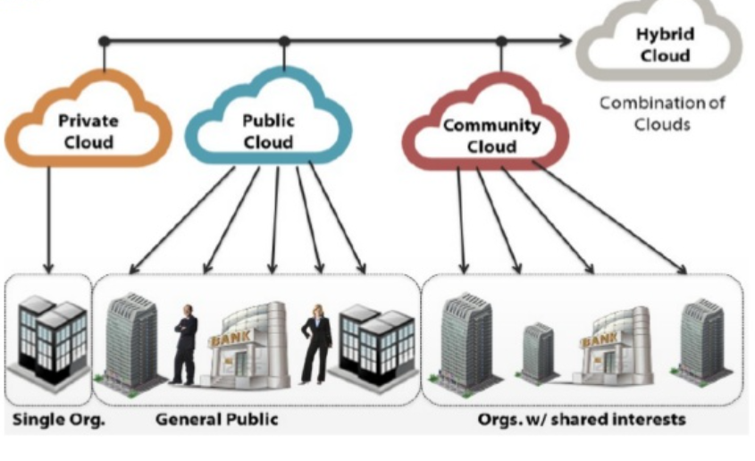

Slide 7
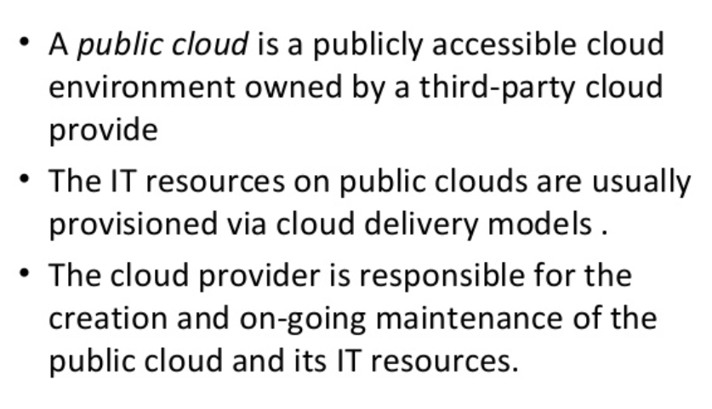
PUBLIC CLOUD

Slide 8
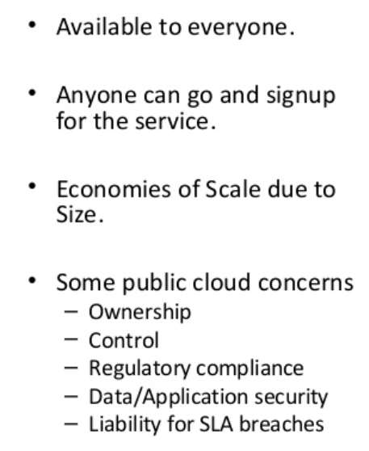
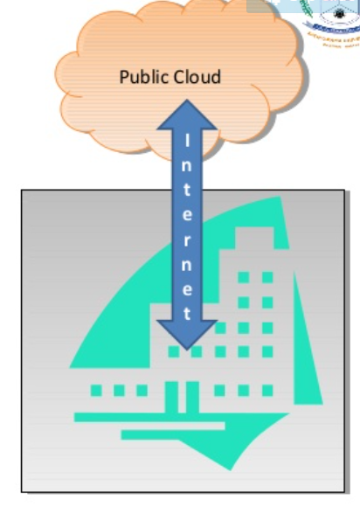
PUBLIC CLOUD

Slide 9
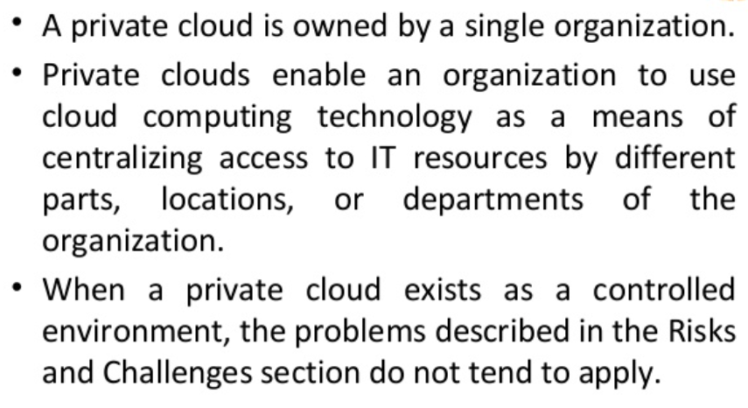
PRIVATE CLOUD

Slide 10
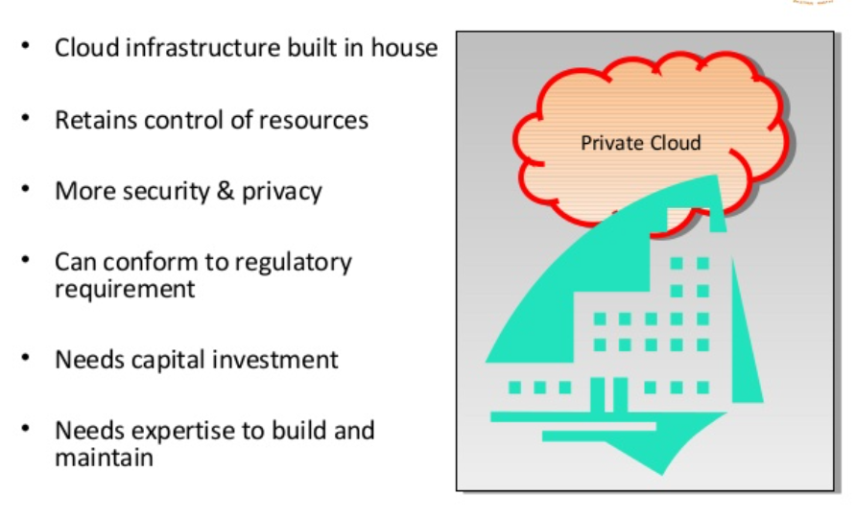
PRIVATE CLOUD

Slide 11
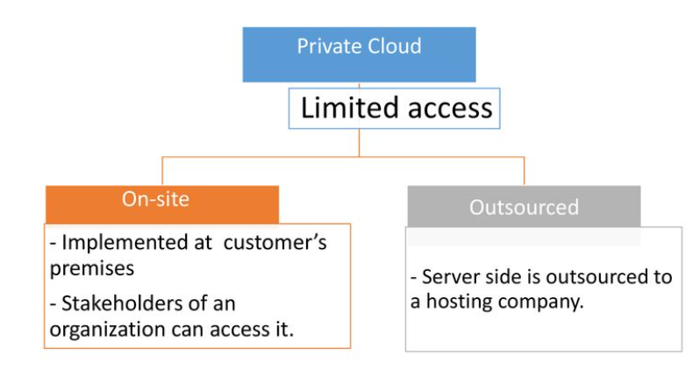
PRIVATE CLOUD

Slide 12
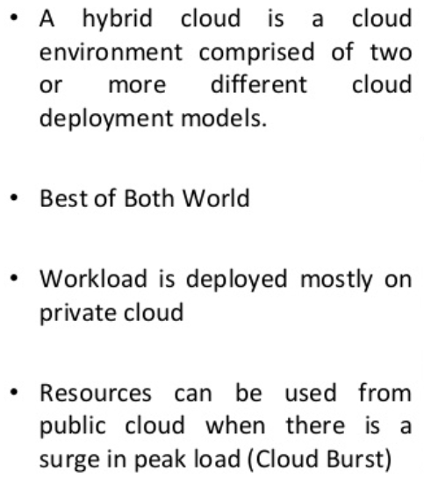
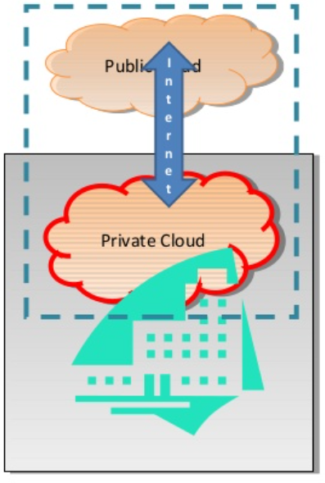
HYBRID CLOUD

Slide 13
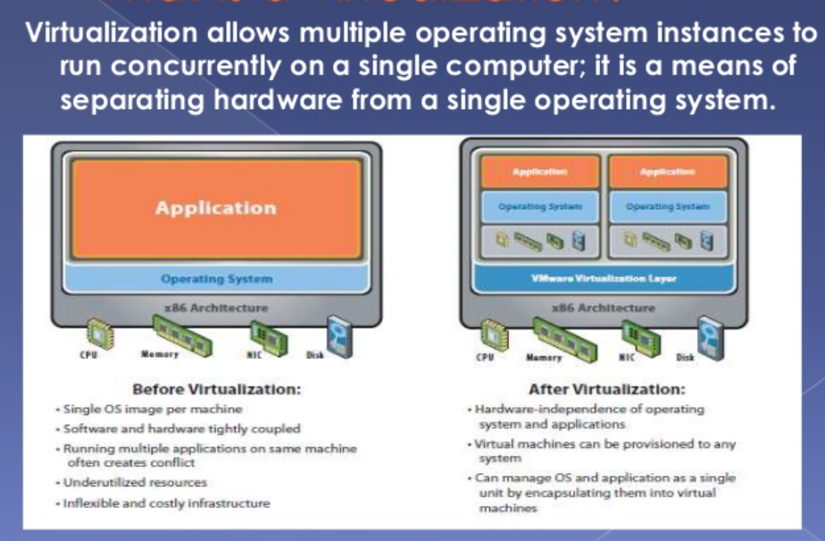
HYPERVISOR WHAT IS VIRTUALIZATION?

Slide 14
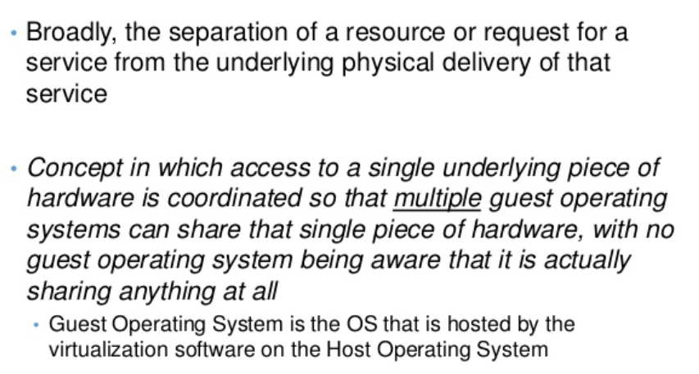
WHAT IS VIRTUALIZATION?

Slide 15
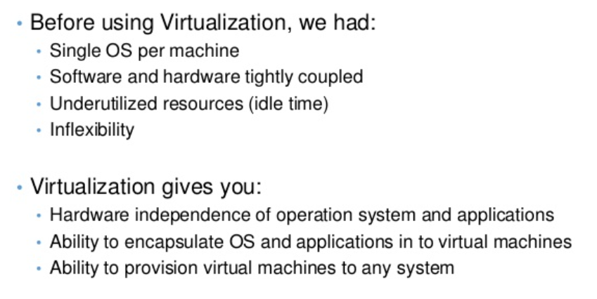
WHAT IS VIRTUALIZATION?

Slide 16
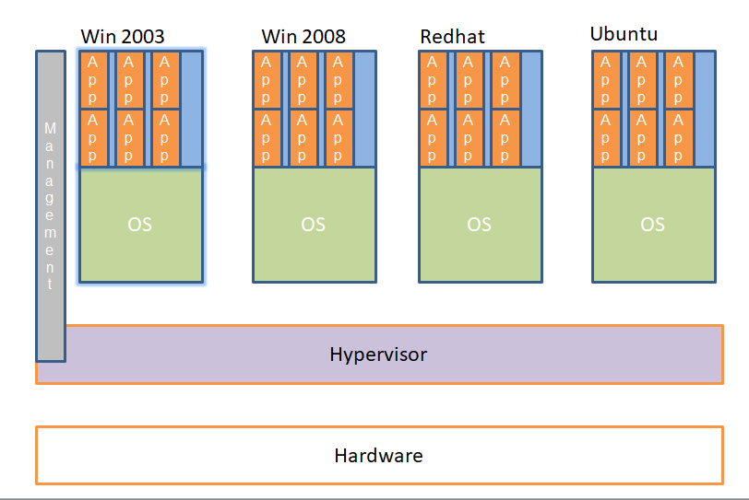
TYPICAL SERVER VIRTUALIZATION DEPLOYMENT

Slide 17
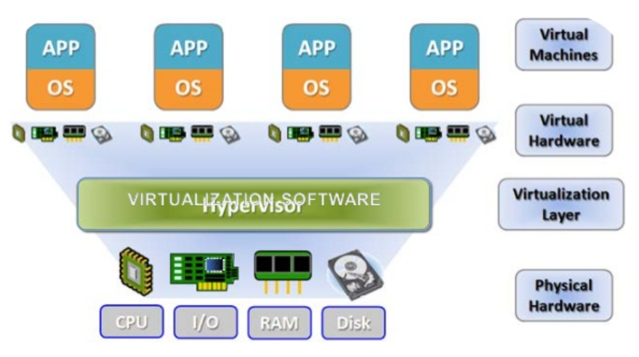

Slide 18
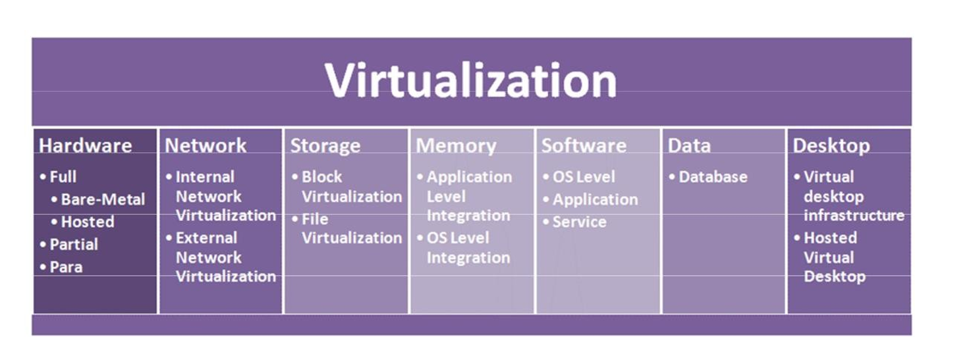
Types of Virtualization

Slide 19
Approaches or ways to virtualizes cloud servers.
Grid Approach
OS - Level Virtualization
Hypervisor-based Virtualization
Software virtualization
Hardware virtualization
Server virtualization

Slide 20
Virtualization
Grid Approach - where the processing workloads are distributed among different physical servers, and their results are then collected as one.
OS - Level Virtualization -Here, multiple instances of an application can run in an isolated form on a single OS
Hypervisor-based Virtualization-With hypervisor's virtualization, there are various sub- approaches to fulfill the goal to run multiple applications & other loads on a single physical host

Slide 21
Virtualization
Hardware Virtualization -It is the abstraction of computing resources from the software that uses cloud resources. It involves embedding virtual machine software into the server's hardware components. That software is called the hypervisor.

Slide 22
Virtualization
Three types of hardware virtualizations
Full Virtualization - Here the hardware architecture is completely simulated. Guest software doesn't need any modification to run any applications
Emulation Virtualization - Here the virtual machine simulates the hardware & is independent. Furthermore, the guest OS doesn't require any modification
Para-Virtualization - Here, the hardware is not simulated; instead the guest software runs its isolated system

Slide 23
Software virtualization
It is also called application virtualization
Software virtualization is similar to that of virtualization except that it is capable to abstract the software installation procedure and create virtual software installation. Many applications & their distributions became typical tasks for IT firms and departments. The mechanism for installing an application differs.
So virtualized software is introduced in which an application that will be installed into its self-contained unit and provide software virtualization. Some of the examples are Virtual Box, VMware, etc
Benefits are Ease of Client Deployment , Software Migration, Easy to Manage

Slide 24
Server virtualization:
In this process, the server resources are kept hidden from the user. This partitioning of physical server into several virtual environments; result in the dedication of one server to perform a single application or task.
This technique is mainly used in web-servers which reduces the cost of web-hosting services. Instead of having separate system for each web-server, multiple virtual servers can run on the same system/computer.

Slide 25
Primary uses of server virtualization are:
To centralize the server administration
Improve the availability of server
Helps in disaster recovery
Ease in development & testing
Make efficient use of server resources.

Slide 26
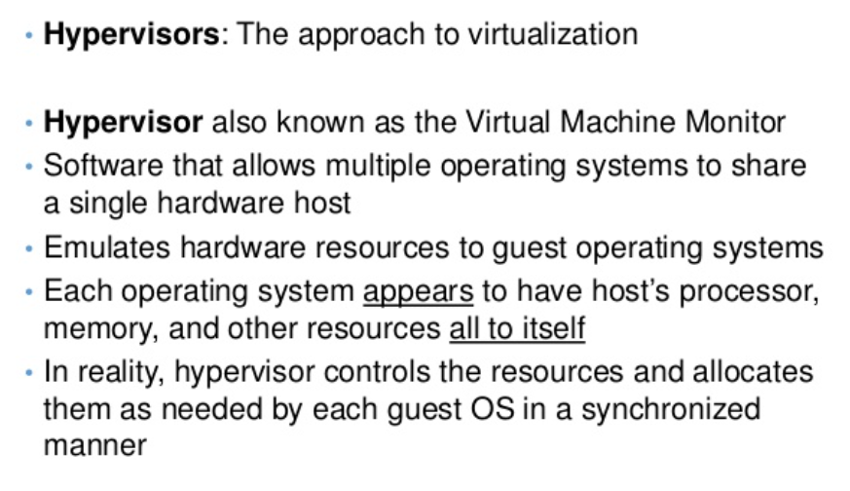
HYPERVISOR

Slide 27
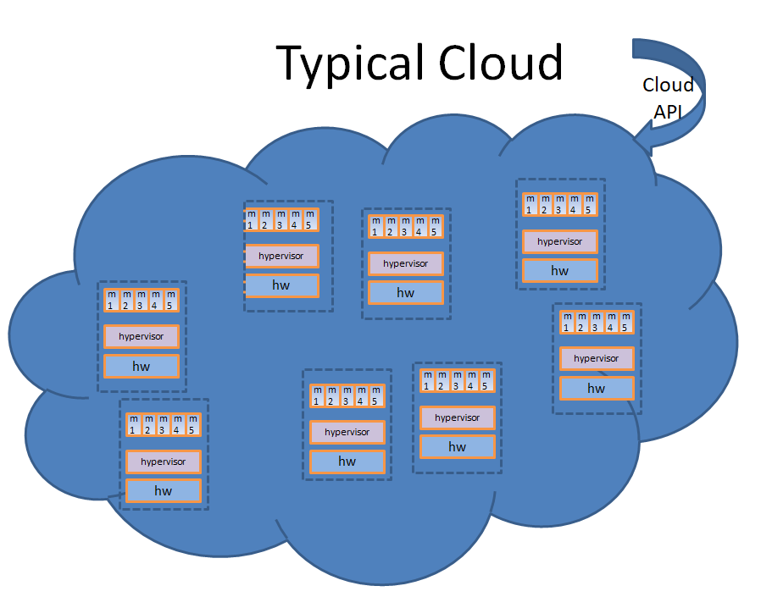

Slide 28
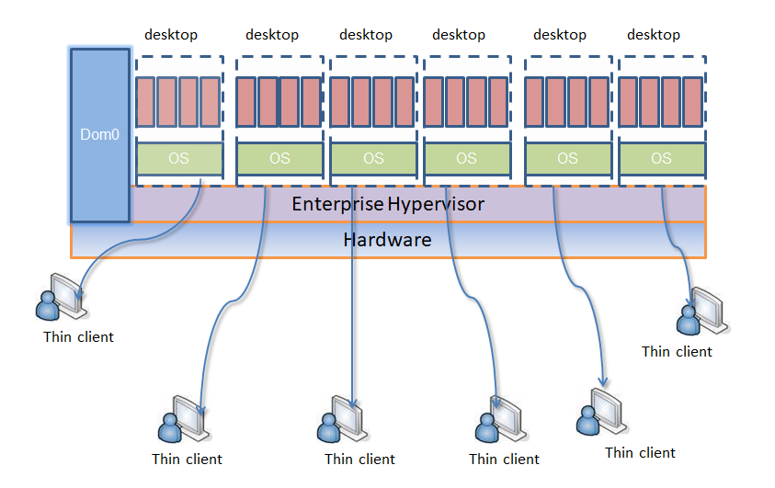
TYPICAL VDI(Virtual Desktop Infrastructure) DEPLOYMENT

Slide 29
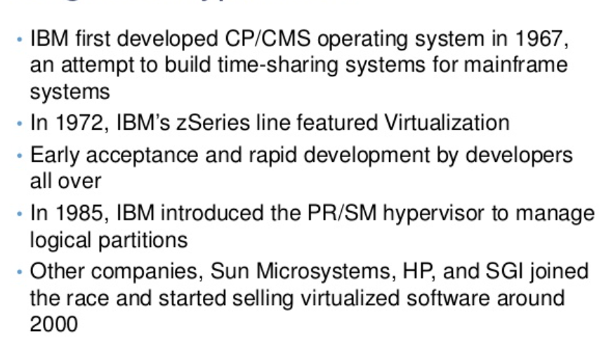
ORIGIN OF HYPERVISOR

Slide 30
SECURITY ISSUES IN HYPERVISOR
Hypervisor is the underlying component of all these architectures. It is a new layer which needs to be protected
Scale of deployments – Just the sheer scale of deployments make this a security nightmare.
Imagine 150 machines running a simultaneous scheduled AV scan on the same physical host. Chokes IO/Disk bandwidth.
Isolation - Machines of a company and its competitor could be running on the same physical machine. Insufficient isolation could lead to disaster
New API’s to access Virtualization/Cloud services.
Bugs in these could lead to compromise of entire infrastructure.

Slide 31
SECURITY SOLUTIONS
Trusted hypervisor
Hyperguard – Phoenix Technologies – A hypervisor integrity scanner in SMM.
Deepwatch – Intel project – Virtualization rootkit scanner
Domain 0 Hardening – Various security solutions to white-list and harden Dom0

Slide 32
SECURITY OPPORTUNITIES
New breed of security products is now possible to protect guest OS’s from being hijacked
Hypervisor based security suites cannot be detected by malware running in the guest
Hypervisors allow introspection of very early boot sequences of the guest, thereby making possible an entire need breed of BIOS rootkit and kernel rootkit scanners

Slide 33
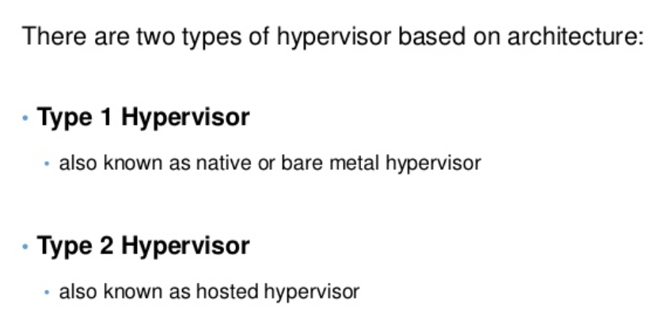
CLASSIFICATIONS OF HYPERVISOR

Slide 34
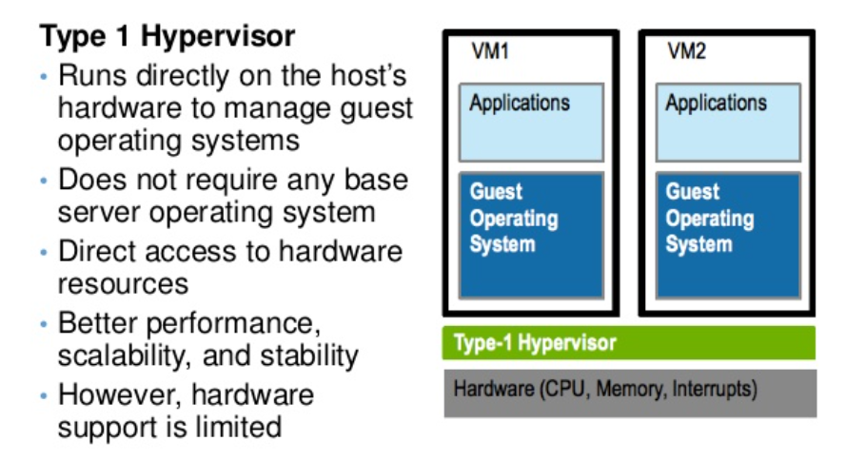
CLASSIFICATIONS OF HYPERVISOR

Slide 35
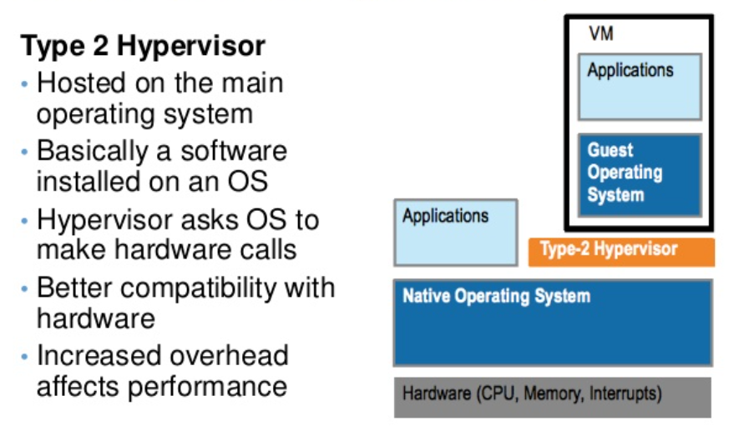
CLASSIFICATIONS OF HYPERVISOR

Slide 36
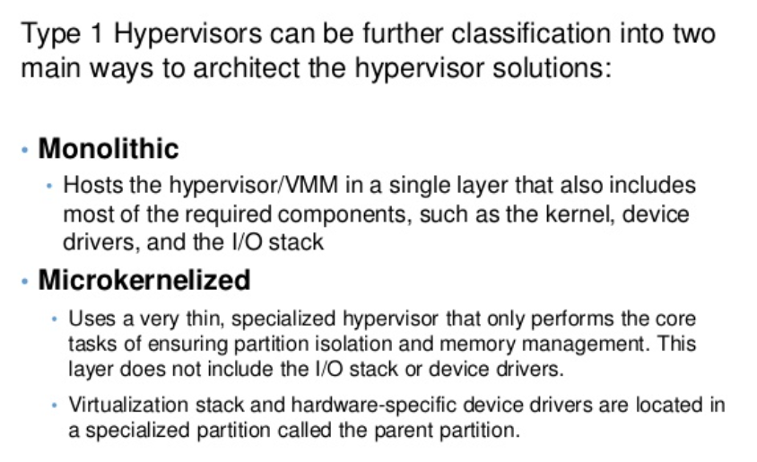
CLASSIFICATIONS OF HYPERVISOR

Slide 37
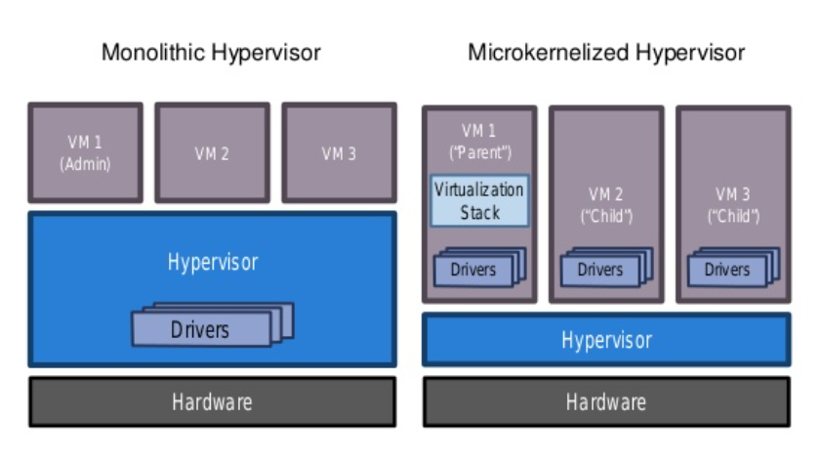

Slide 38
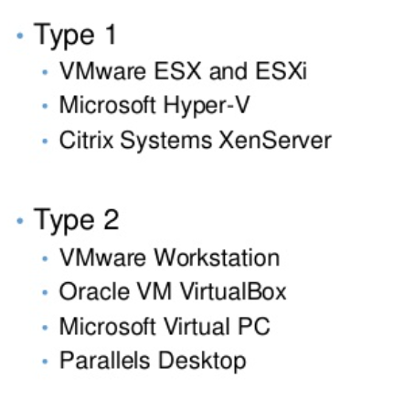
LEADING HYPERVISORS

Slide 39
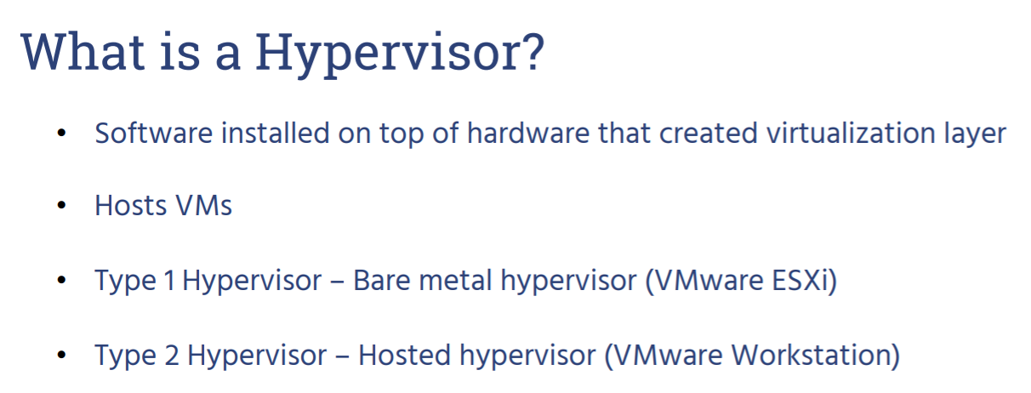
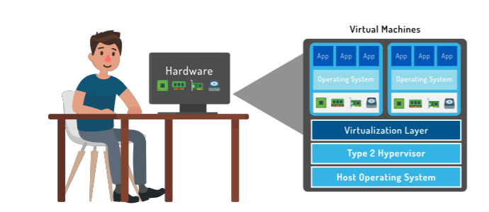

Slide 40
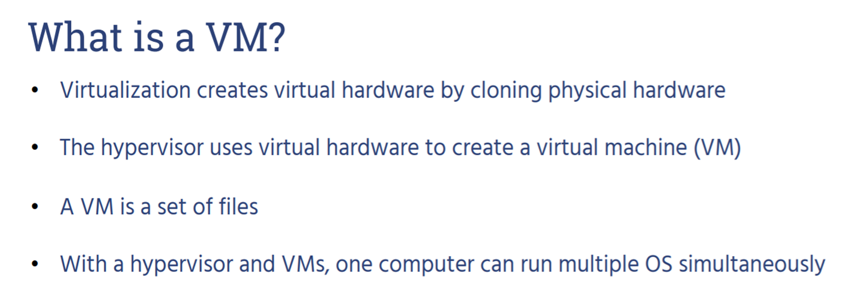
CASE STUDIES : VMware

Slide 41
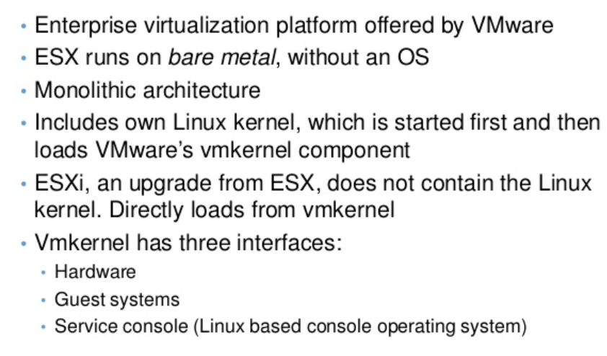
VMware ESX (Elastic Sky X) and ESX i (ESX Integrated)

Slide 42
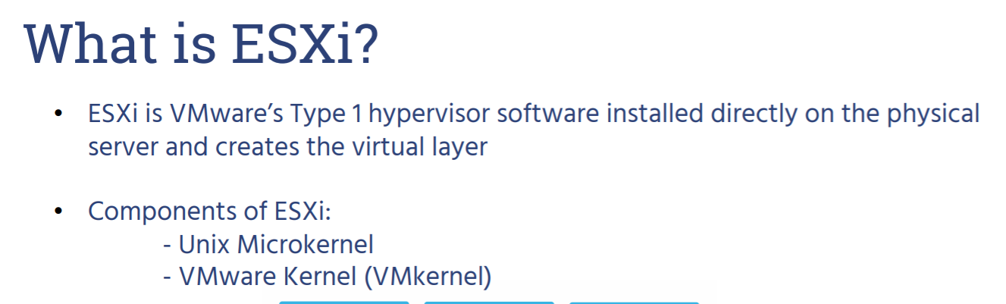
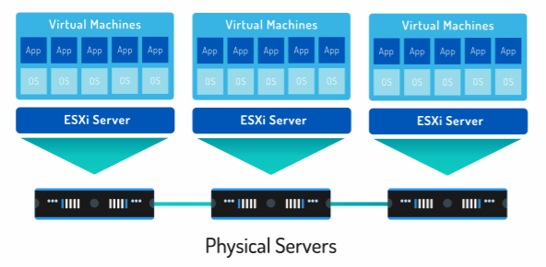

Slide 43
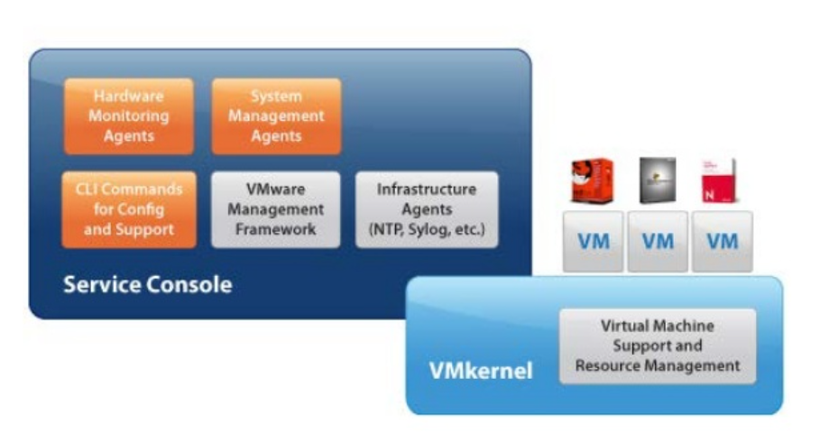
VMware ESX Architecture

Slide 44
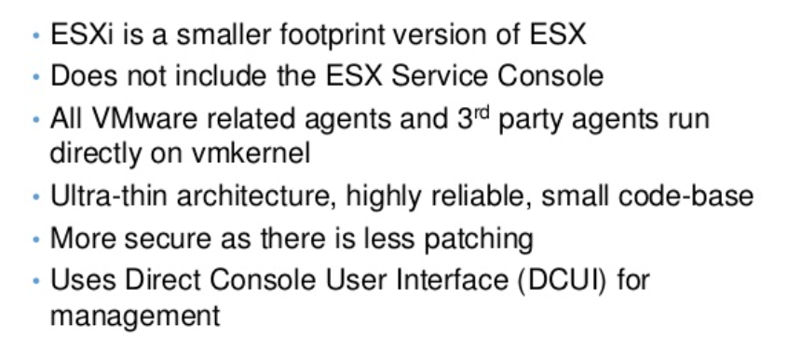
VMware ESXi

Slide 45
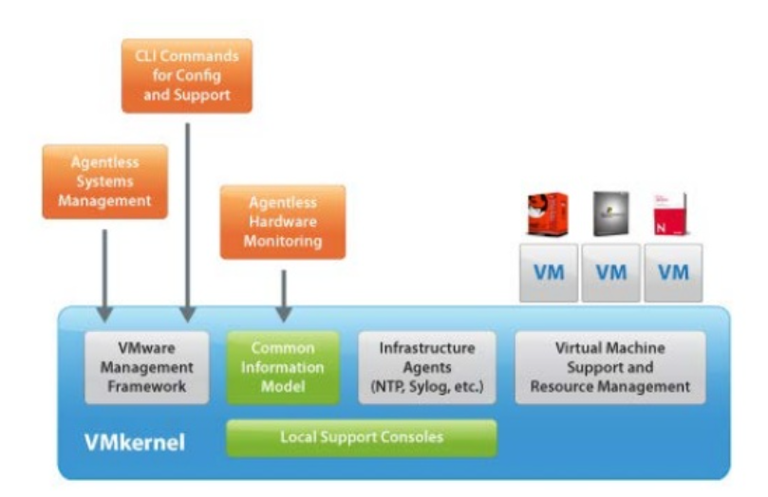
VMware ESXi Architecture

Slide 46
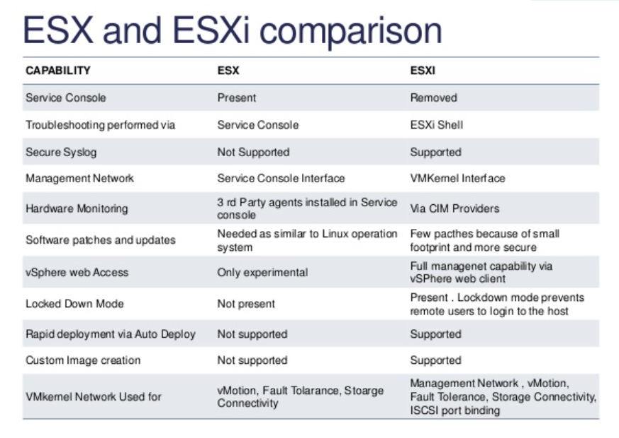

Slide 47
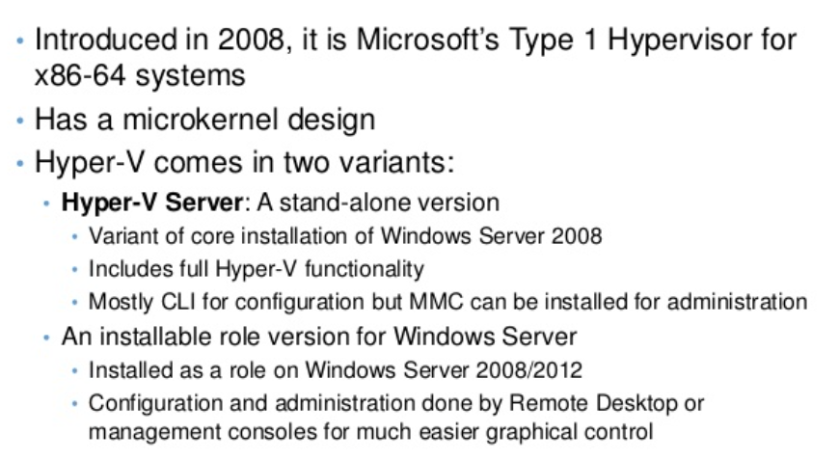
CASE STUDIES : HYPER V

Slide 48
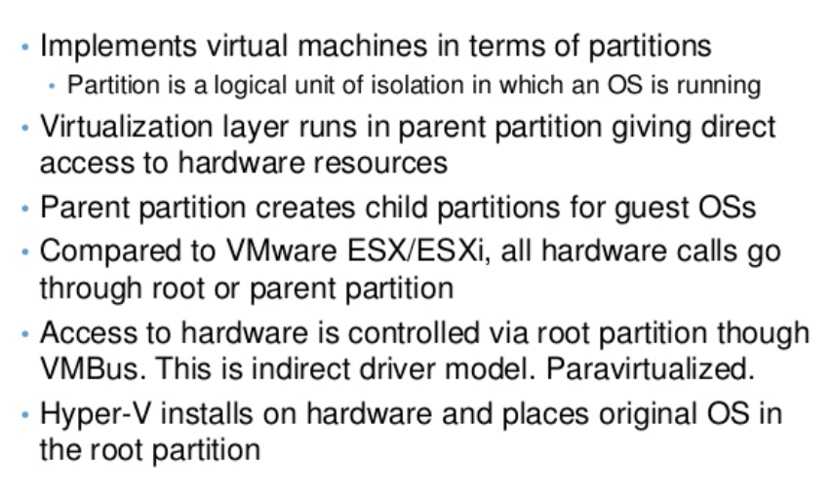
HYPER V ARCHITECTURE

Slide 49
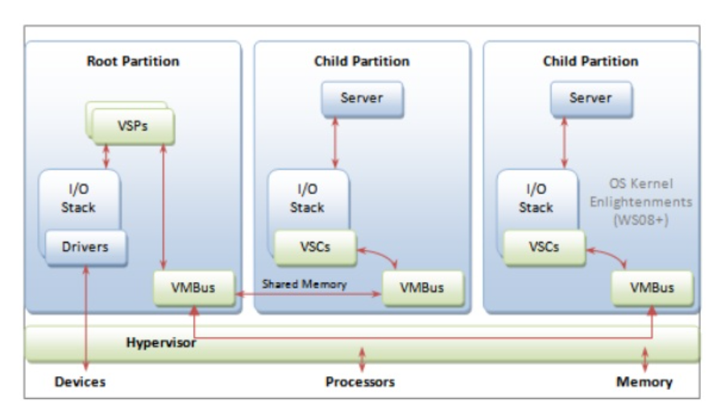
HYPER V ARCHITECTURE
Virtualization Service Client (VSC) Virtualization Service Provider(VSP)

Slide 50
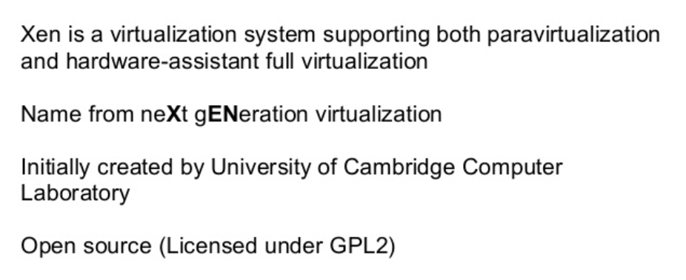
CASE STUDIES : XEN

Slide 51
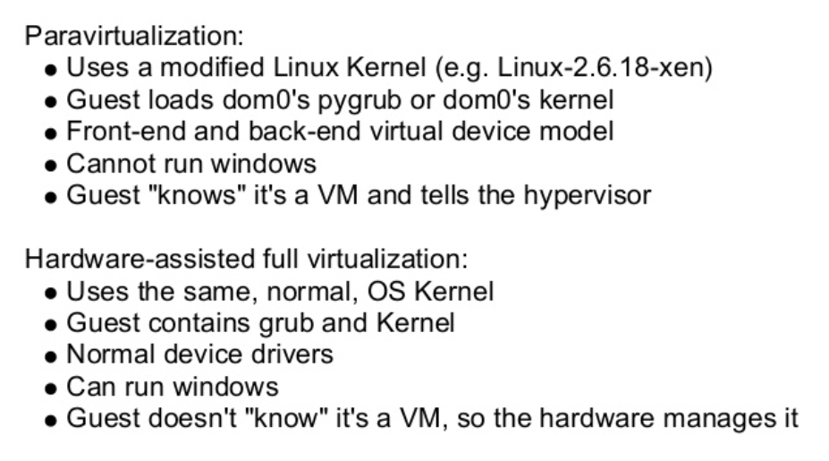
VIRTUALIZATION IN XEN

Slide 52
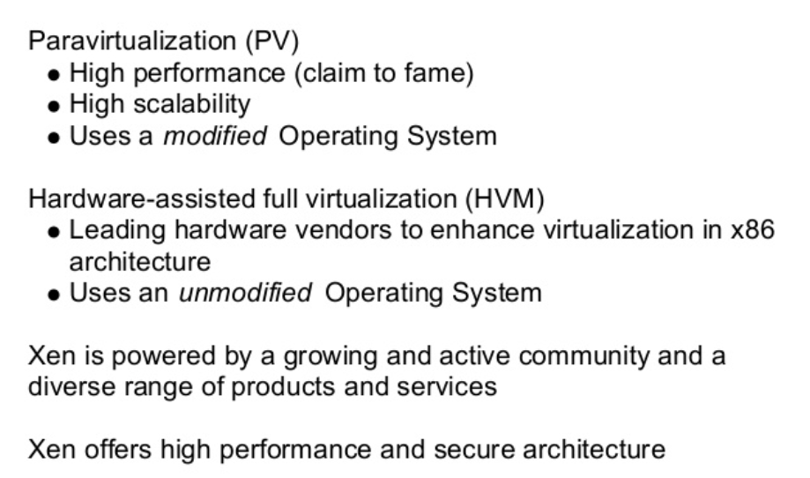
WHY TO USE XEN?

Slide 53
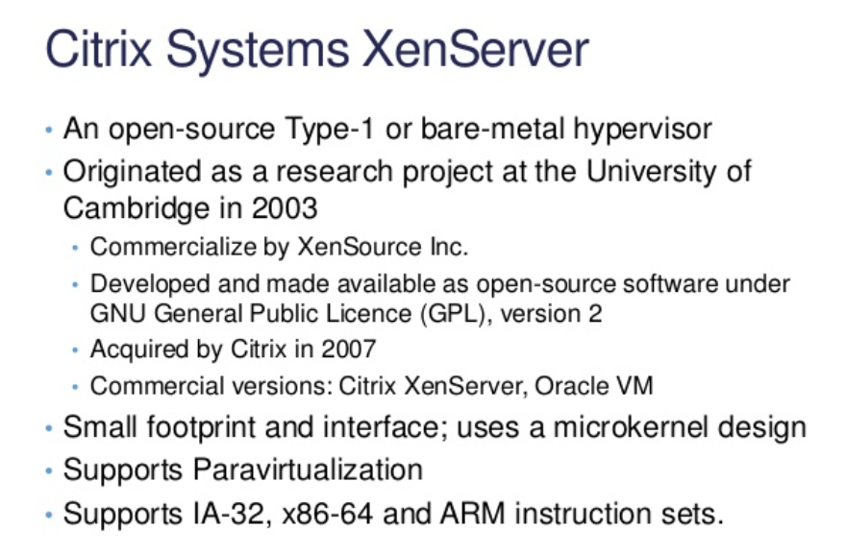
CASE STUDIES : XEN

Slide 54
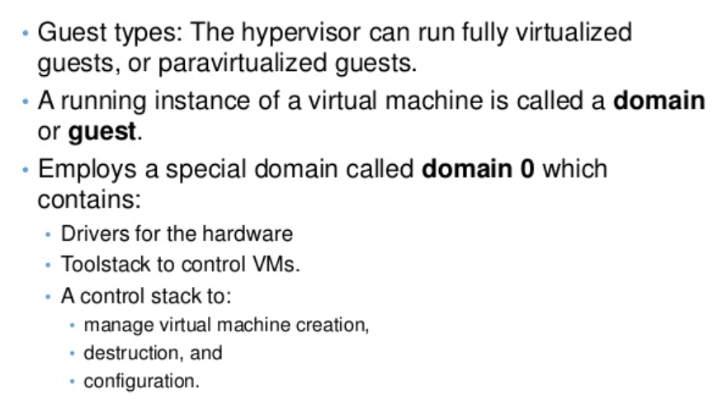
XEN ARCHITECTURE

Slide 55
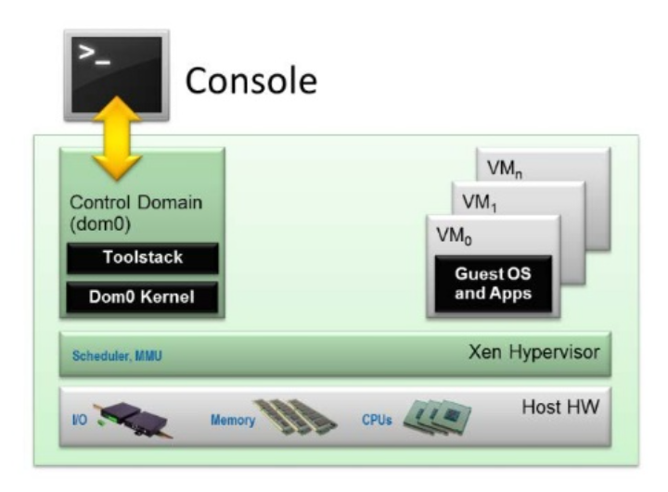
XEN ARCHITECTURE

Slide 56
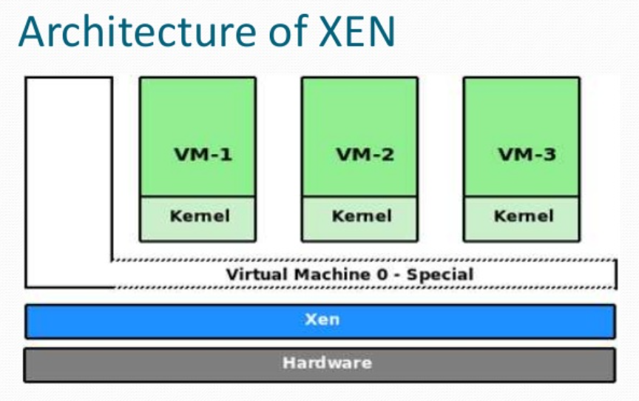
ARCHITECTURE OF XEN

Slide 57
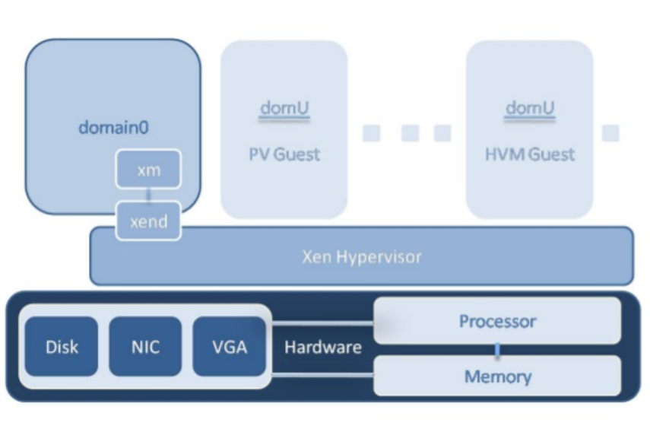
ARCHITECTURE OF XEN

Slide 58

CASE STUDIES : KVM

Slide 59

KVM

Slide 60

Virtual Private Servers: Cloud services

Slide 61


CASE STUDIES : VIRTUAL BOX

Slide 62


Slide 63

KEY FEATURES OF VIRTUAL BOX

Slide 64

KEY FEATURES OF VIRTUAL BOX

Slide 65

CASE STUDIES : EUCALYPTUS

Slide 66

WHY EUCALYPTUS?

Slide 67

WHY EUCALYPTUS?

Slide 68

WHY EUCALYPTUS?

Slide 69

SECURITY BASED EUCALYPTUS

Slide 70


COMPONENTS OF EUCALYPTUS

Slide 71

ARCHITECTURE OF EUCALYPTUS

Slide 72

COMPONENTS OF EUCALYPTUS

Slide 73

COMPONENTS OF EUCALYPTUS

Slide 74


Slide 75

COMPONENTS OF EUCALYPTUS

Slide 76



Slide 77

BENEFITS OF EUCALYPTUS

Slide 78

ADVANTAGES OF HYPERVISOR

Slide 79

ADVANTAGES OF HYPERVISOR

Slide 80

DISADVANTAGES

Slide 81
OS Virtualization
A virtual machine (VM) is a software-defined computer with its own operating system that runs on a host server with a different underlying operating system.
Virtual hosts are able to share resources between multiple guests, or virtual machines, each with their own operating system instance.

Slide 82
Basic types of virtual machines
process VM
system VMs.

Slide 83
A process virtual machine allows you to run a single process as an application on a host machine. An example of a process virtual machine is the Java Virtual Machine (JVM) which allows any system to run Java applications as if they were native to the system.
A system virtual machine is a fully virtualized VM designed to be a substitute for a physical machine. It runs on a different host machine by utilizing a hypervisor such as VMware ESXi to access the underlying machine’s resources.

Slide 84
Server virtualization
When it comes to servers, a single host can potentially run hundreds of virtual machines, each with independent operating systems. Keeping operating systems separate means that one host can support both Linux and Windows servers simultaneously.
A virtual host can be configured to use thin provisioning as well, which means virtual machines only use resources they absolutely need at that time. This allows administrators to optimize resource allocation and reduce the amount of hardware that a business needs to own.

Slide 85
How a Virtual Machine Works
Virtual machine architecture can be separated into four different components, listed from the bottom up:
An underlying system which includes the physical machine and its operating system. Bare metal hypervisors do not require an underlying operating system at this layer.
A hypervisor which acts as a communication and translation layer.
Multiple virtual machines that use the host’s resources by communicating with the hypervisor.
Applications and processes that run on each guest’s operating system.

Slide 86
Hypervisor configuration
The hypervisor needs to be appropriately configured before deploying any virtual machines. Using KVM, an open source virtualization technology built into Linux, administrators can create virtual machines from a command line interface.

Slide 87
Summary on Virtual Machines
Virtual machines reduce the amount of physical hardware organizations have to purchase and allow them to run multiple operating systems on one underlying host.
Running multiple virtual machines on a physical host can optimize the use of system resources.
Testing applications in different environments can be done quickly and cost-free by spinning up and decommissioning virtual machines.

Slide 88
References:
Windows Azure: https://www.tutorialspoint.com/microsoft_azure/microsoft_azure_windows.htm
Windows Azure: https://en.wikipedia.org/wiki/Microsoft_Azure
Disaster Recovery: https://www.nakivo.com/blog/disaster-recovery-in-cloud-computing/
VM:https://blog.stackpath.com/virtual-machine/

